Slide 1
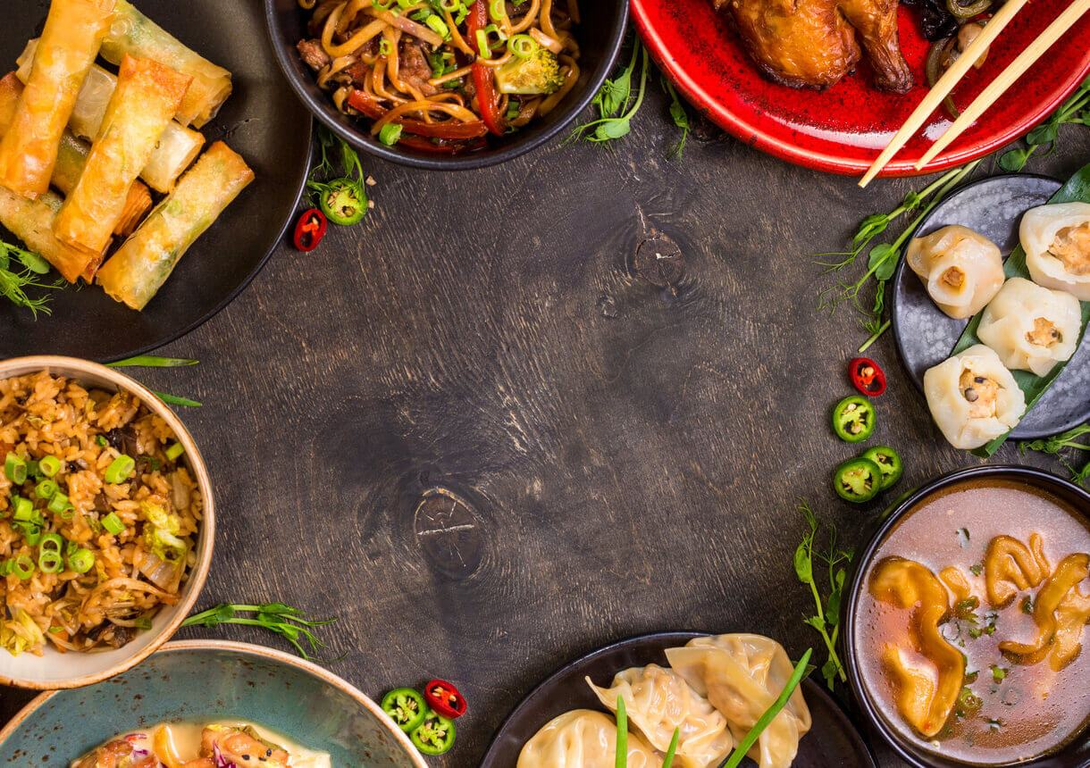
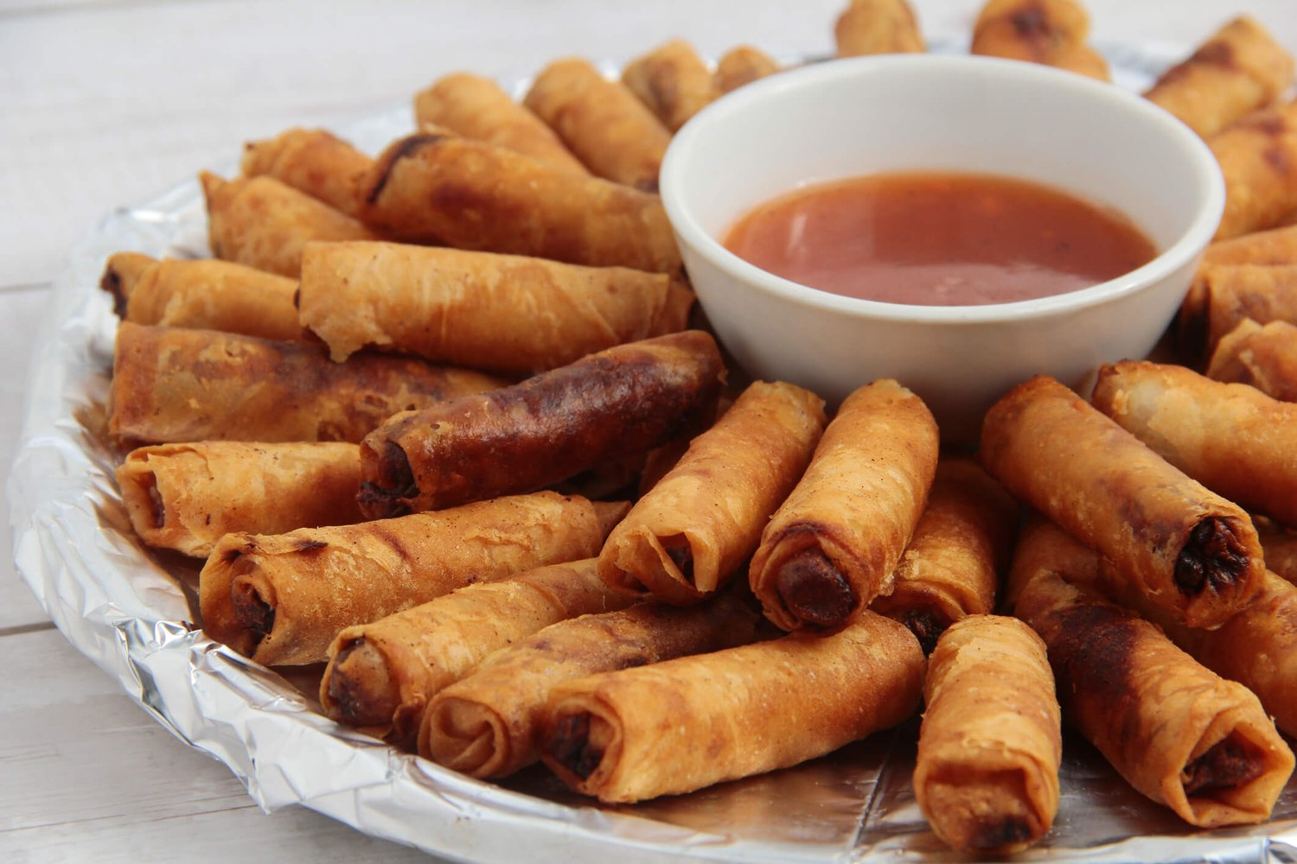
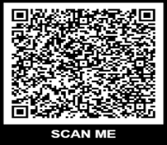
St. Raymond of Peñafort
& Knights of Columbus,
St. John Bosco Council
Invite you…
.
Asian Fusion Dinner
2026- SOLD OUT
3rd year in a row!
Saturday October 3, 6:30pm
In the Parish Hall
Bring your family and friends for an evening of friendship, fellowship, music and great Asian food! Great Door Prizes, too!
Lumpia (Filipino egg rolls)
Kimbap (Korean sushi)
Pancit (rice noodles)
Filipino BBQ Skewers
Bo Kho (Vietnamese Beef Stew)
Samosa (Indian pastry with savory filling)
Steamed Rice
Mixed Vegetables
Asian Desserts
For more information and to purchase tickets,
visit www.straymonds.org/asian-fusian-dinner
**Proceeds will support the Parish Our Lady of Ransom Scholarship Fund

